Slide 1

A Graph Database for the Real World
A powerful and scalable database for storing and querying relationships

Slide 2
What is a graph database?
A graph database is a type of database that stores data as nodes and relationships
The nodes represent entities, such as people, products, or events
The relationships represent the connections between entities, such as friendships, purchases, or events

Slide 3
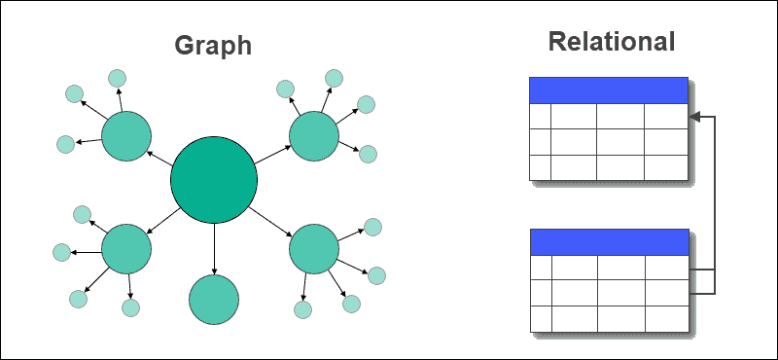
Why use a graph database?
Graph databases are well-suited for storing and querying data with complex relationships
They are also efficient for tasks such as pathfinding, social network analysis, and fraud detection

Slide 4
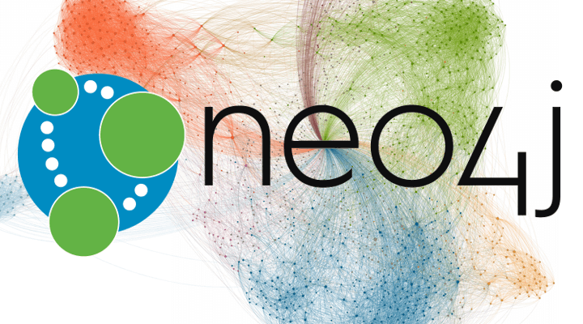
What is neo4j ?
Neo4j is a graph database management system developed by Neo4j, Inc.
Neo4j is used by a wide range of organizations, including financial services, retail, telecommunications, manufacturing, government, healthcare, energy, media and entertainment, and logistics and transportation.

Slide 5
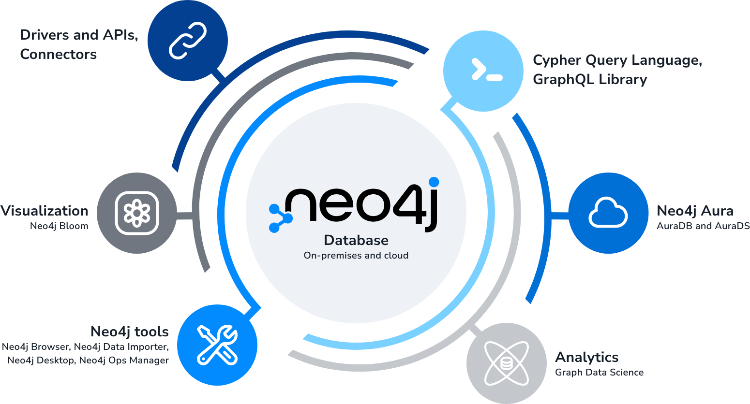
Features of Neo4j

Slide 6
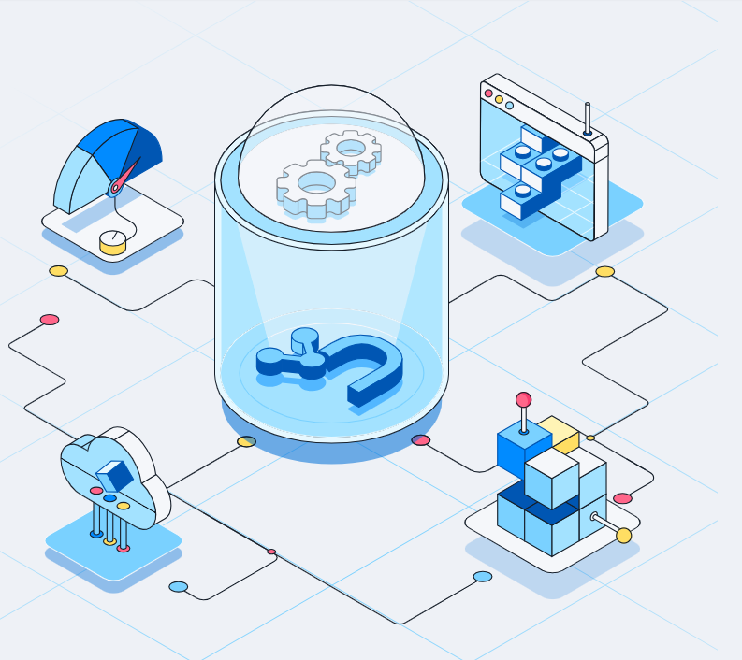
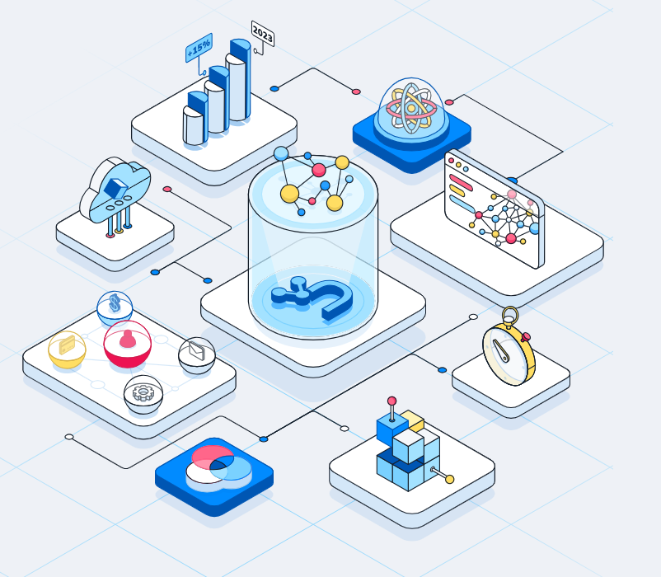
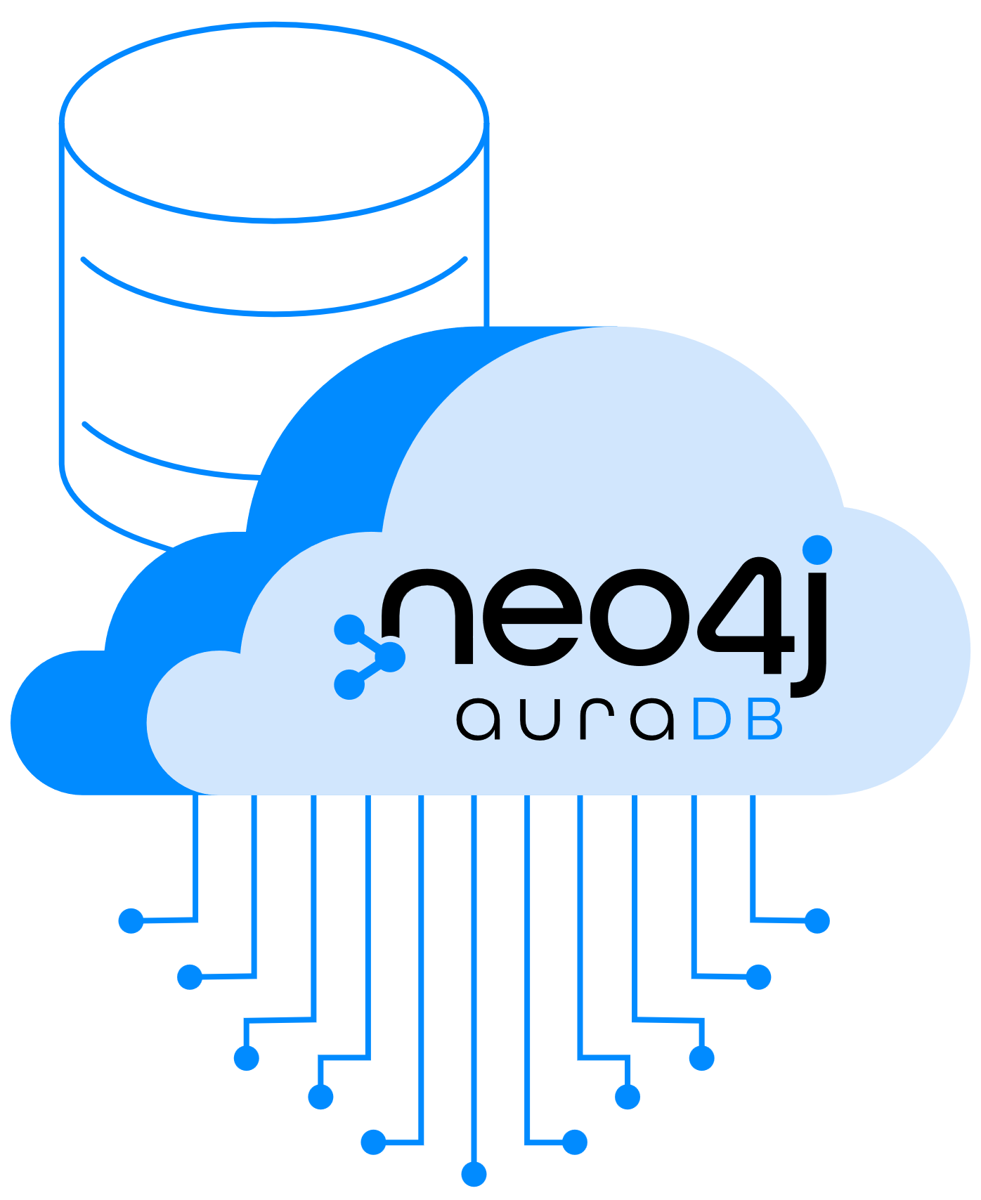
neo4j Products
Neo4j Graph Database
Neo4j Graph Data Science
neo4j auraDB

Slide 7
Use cases for Neo4j
Fraud detection
Social network analysis
Recommendation engines
Knowledge graphs
Supply chain management
Transportation logistics

Slide 8





Organizations Which Use neo4j

Slide 9
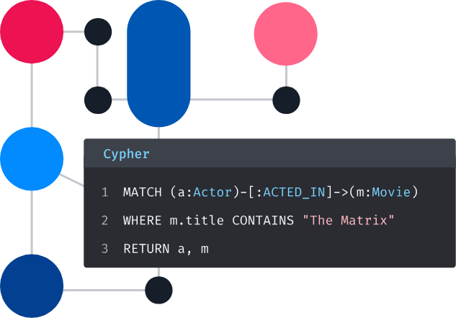
Neo4j Cypher Query Language
Cypher is a declarative graph query language that is used by developers worldwide. Created by Neo4j, Cypher provides expressive and efficient queries for property graphs.

Slide 10
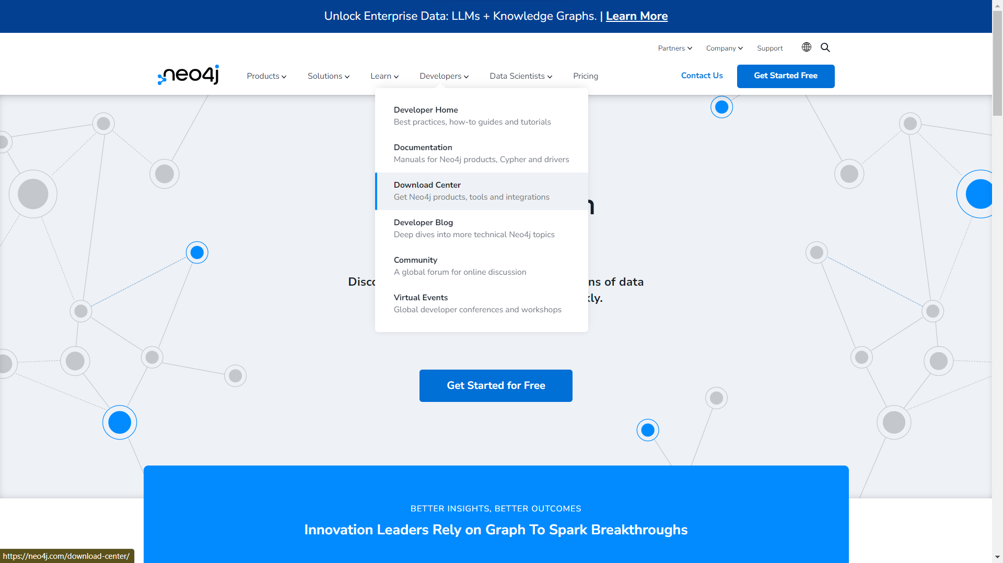

Slide 11
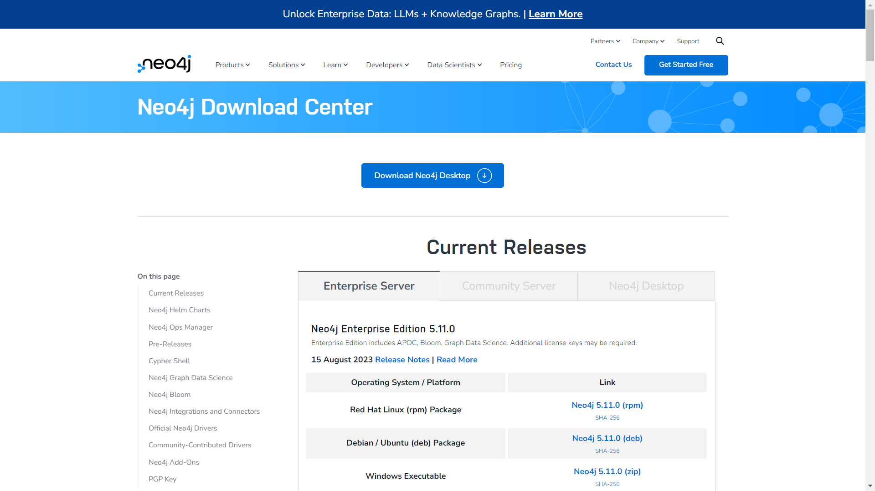

Slide 12
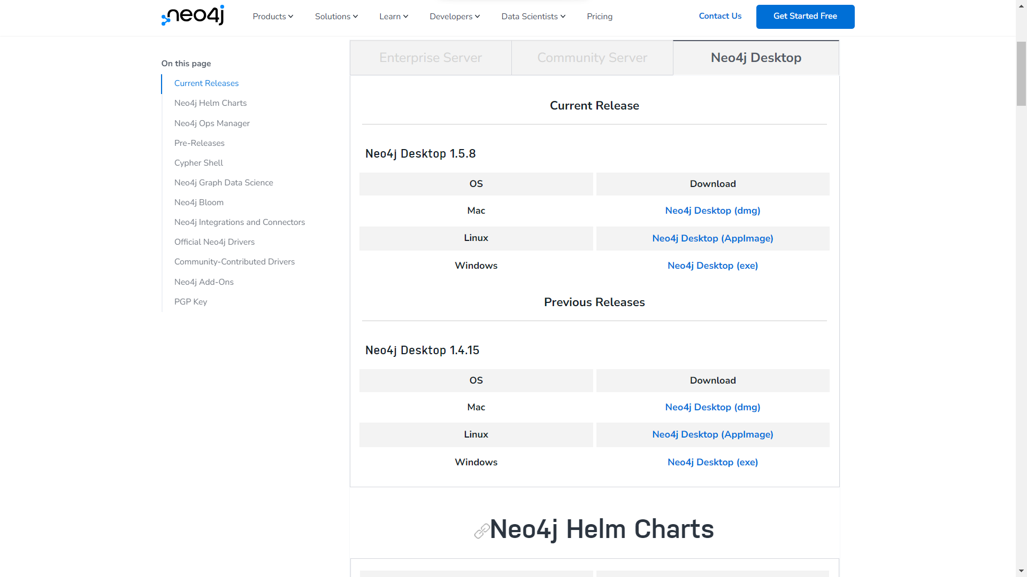

Slide 13
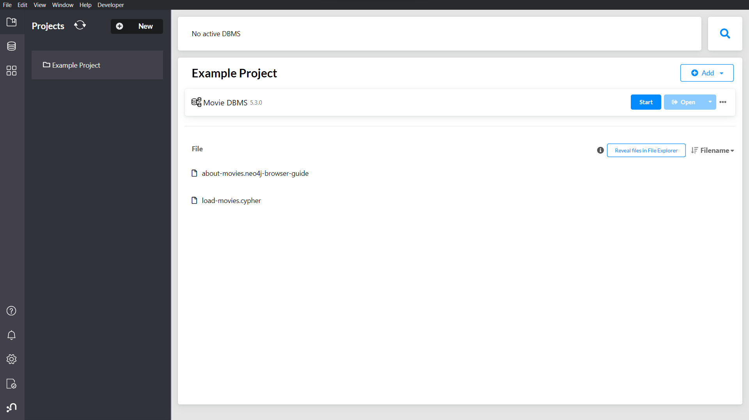

Slide 14
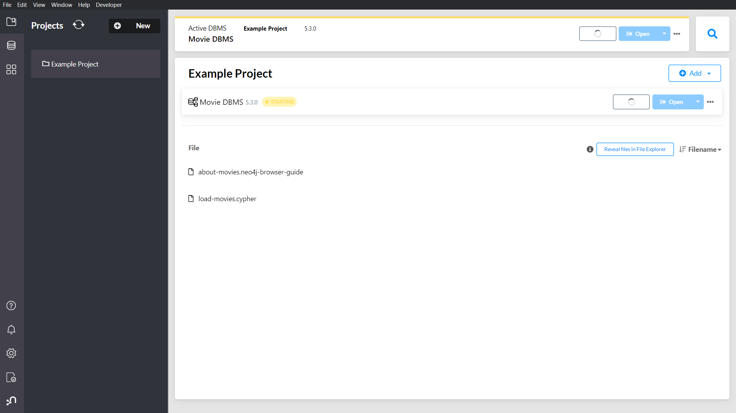

Slide 15
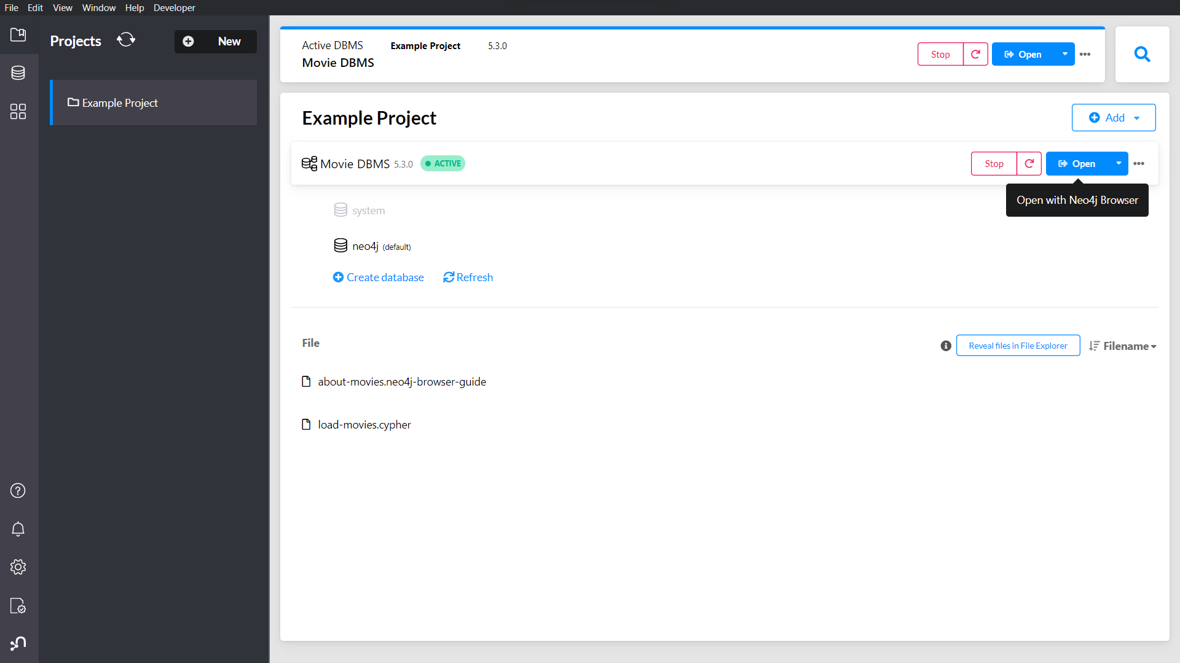

Slide 16
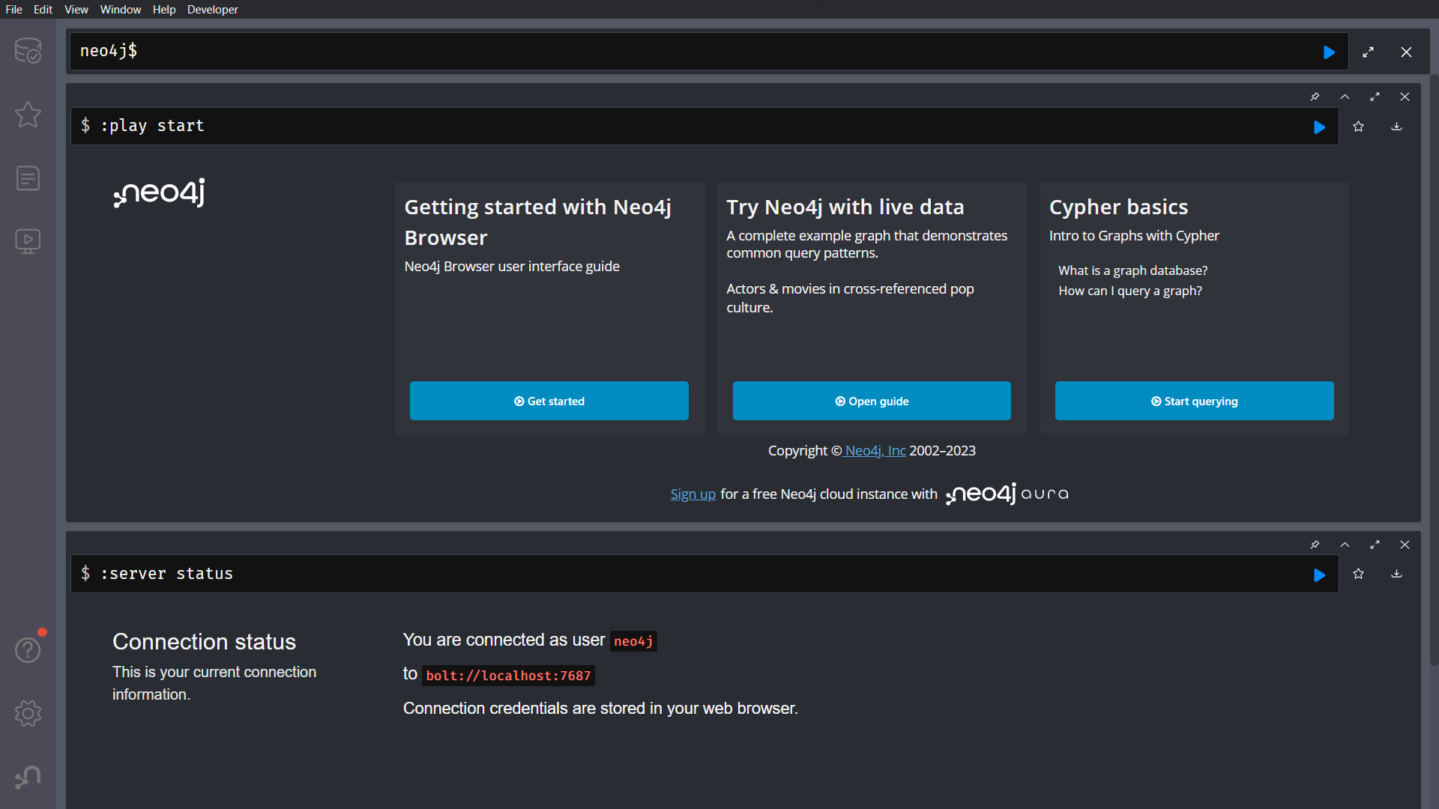

Slide 17
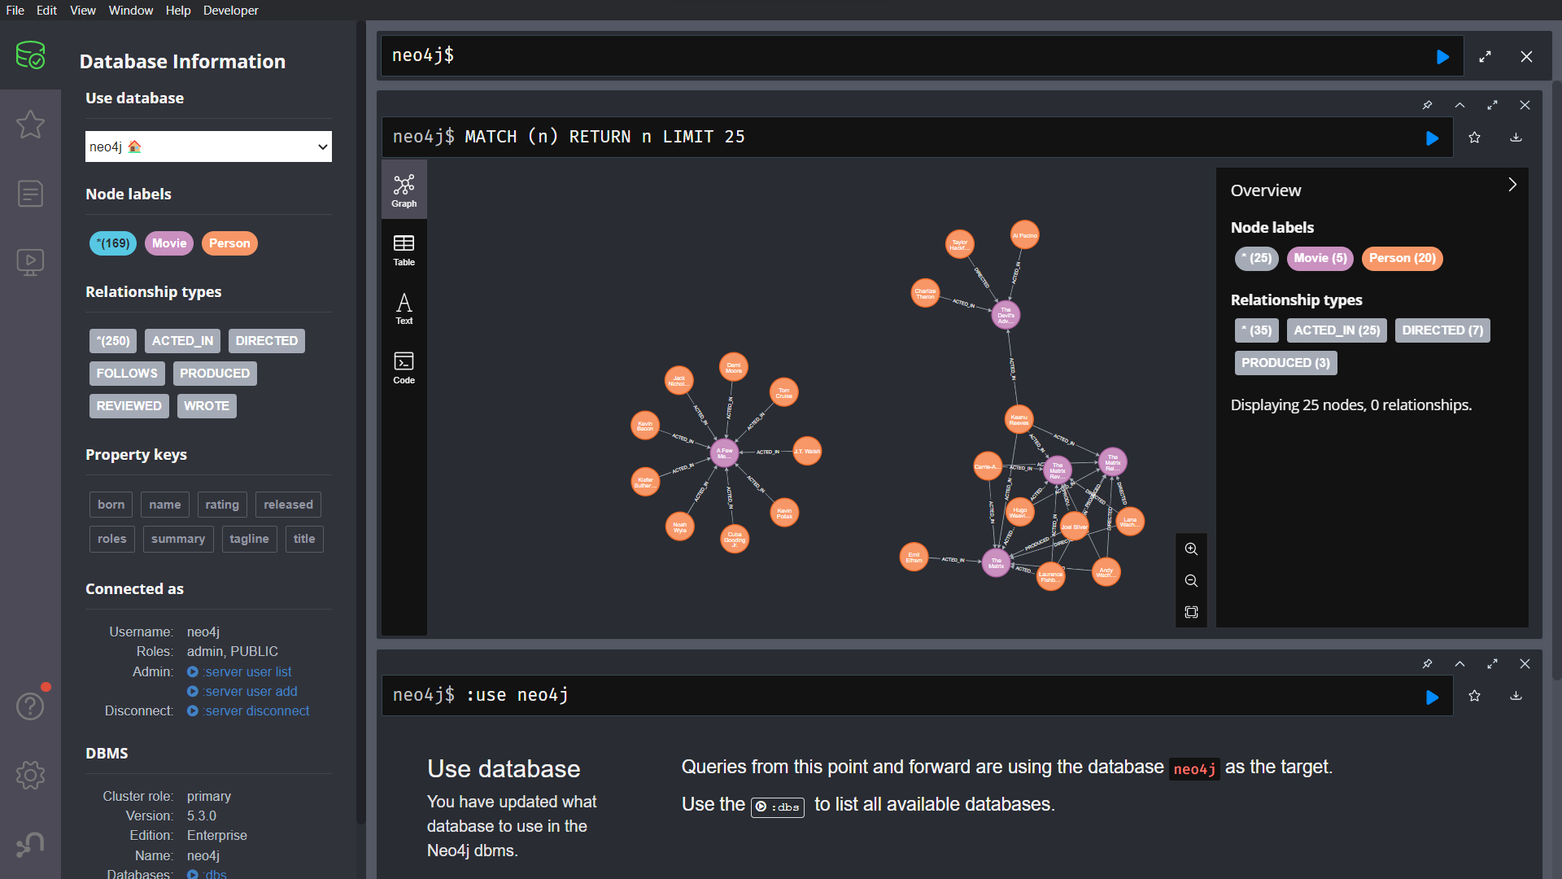

Slide 18
